Slide 1
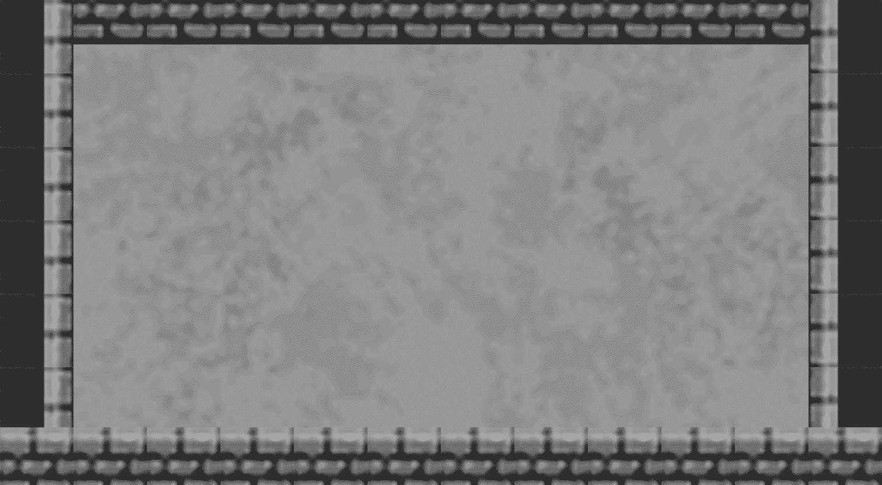
Notes:
Trailer will go here. The presentation will open with the trailer before going through the presentation. This will be seamless when everything is cut together into one video

Slide 2

Notes:
Voiceover: Welcome to Hookshot Heroes, a game about exploring dungeons, fighting off emeries and collecting treasure.

Slide 3
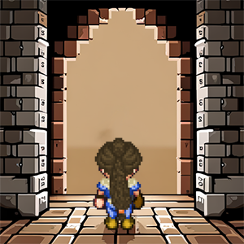
In a realm shrouded in mystery, Lidia, a brave and determined heroine, embarks on a perilous journey. Drawn by the allure of hidden treasures and ancient secrets, she fearlessly enters the dungeons. Empowered by the legendary "hookshot," a grappling hook that fused to her arm, Lidia defies danger and navigates treacherous terrain. With each triumph over enemies and the acquisition of precious loot, she inches closer to the ultimate prize. Driven by unwavering bravery, Lidia's quest for glory unfolds as she unravels the depths of the dungeons, leaving an indelible mark upon the annals of Eldoria's history.
Notes:
Voiceover: You find yourself playing as Lidia, a brave and determined heroine. Throughout the games journey, Lindia travels deeper into the dungeons of Eldoria seeking treasure. Equipped with the legendary hookshoot, Lidia is able to fully explore these dungeons, traverse the treacherous pits of lava, fight off enemies and collect treasures to increase her score!

Slide 4




Lidia and Shura, steadfast friends and intrepid adventurers, embark on a journey into the treacherous dungeons. With Linda's fearless spirit and mastery of the hookshot and Shura's seasoned warrior skills, they navigate danger, collect priceless treasures, and conquer formidable enemies. United by their unbreakable bond, Lidia and Shura stand as a formidable team, destined to uncover the greatest prize the dungeons hold.
Avalon, a timid and fearful soul, was discovered by Linda in the depths of the dungeons. With Linda's compassionate heart and unwavering support, she becomes Avalon's guiding light, leading her through the perilous corridors towards safety. In Linda's presence, Avalon finds solace and the strength to face her fears, forging a friendship that will illuminate their path to freedom.
Sarah, the wise quest giver, awaits at the entrance of the dungeon, her eyes brimming with knowledge and ancient wisdom. She imparts her profound guidance to Linda, sharing tales of forgotten treasures and the lurking dangers that lie ahead.
Notes:
Voiceover: Lidia is not alone on this adventure. The village of Eldoria is full of interesting characters to welcome Lidia and Shura, provide information and same may even need the helping hand of these two adventurers!

Slide 5




Flying Terror - The dungeon harbors a menacing sight - an eyeball with wings, soaring through the air, casting an eerie shadow of fear upon all who encounter it.
From the depths of the dungeon, skeletal warriors emerge, their bony forms driven by an insatiable hunger for battle, relentlessly pursuing any intruders who dare disturb their eternal rest.
A formidable foe guards the heart of the dungeon - the Minotaur, booking your path forward, ready to challenge any who dares to face its wrath.
At the deepest part of the dungeon, the Wizard awaits, a master of arcane arts. With a wicked gleam in their eyes, they unleash orbs of destructive magic, their power unrivaled and their intentions shrouded in mystery.
Notes:
Voiceover: The dungeons are not just full of treasure, but also foul creatures. Throughout your journey, you’ll encounter a range of creatures that you will need to defend yourself against. Enemies you’ll find throughout the dungeon are the flying terror and skeletal warriors, with the powerful brute that is the minotaur and wizard that you’ll encounter as bosses; the hookshot will become an invaluable weapon in defeating the enemies you encounter throughout your perilous journey.

Slide 6




Gleaming with golden allure, a small coin awaits the players' grasp, granting them 10 precious points to bolster their score and pave their path to victory.
Concealed amidst treacherous perils, a hidden treasure chest beckons the players' exploration. Unlocking its secrets, which reward them with a bountiful 100 points, a testament to their cunning and determination.
A life-sustaining gift in the depths of darkness, a fruit barrel offers a vital respite. Consuming its juicy contents grants the players an extra life, fortifying their resolve and ensuring their continued pursuit.
Tread with caution, for within the shadows lurks a malevolent force. Encountering a bomb inflicts a dire consequence, deducting one precious life from the player.
Notes:
Voiceover: The dungeons are full of items that will hurt or help intrepid explores. In order to complete the adventure with the highest score, collecting these items are key. Though some may slightly be out of reach, or become a hazard if not careful. Effective planning and use of the grapplehook will clear the path, as well as grab hard to reach treasure, resulting in a higher score.

Slide 7
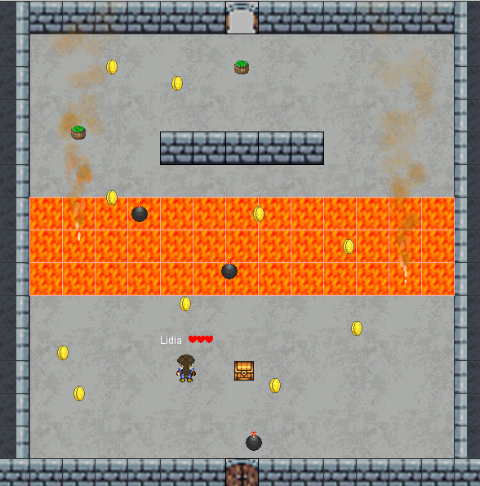
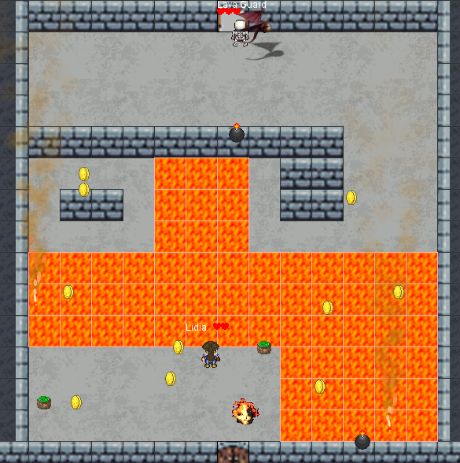
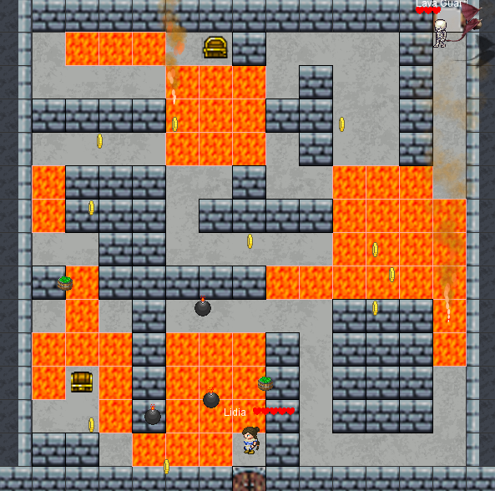
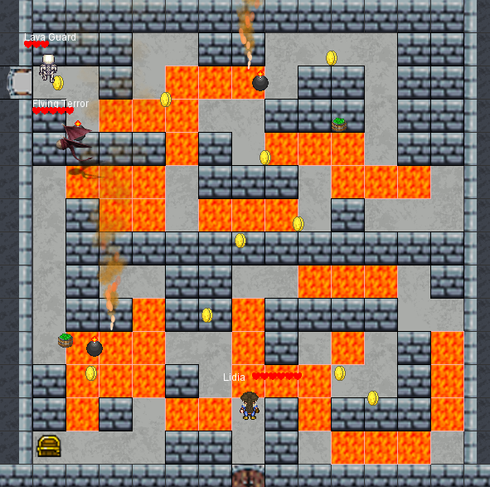
10 unique maze like level, that start off easy and progressively get harder.
Each level is full of coins, treasure chest and hazards!
Each level can be completed in single player mode, two player mode or quest mode
Notes:
Voiceover: There are 10 unique maze like dungeons to explore. Each getting increasingly harder. This gives the player time to understand the abilities of their character before being faced with harder challengers. There are different branching paths that allow a 2nd play through to be different to the first. All levels are playable in the different modes – single player, two player and quest mode.

Slide 8
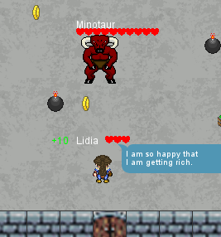
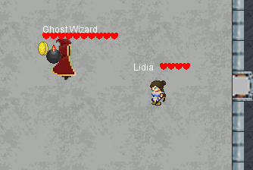
2 different boss fights to challenge the player as they process through the levels. Each boss has an A.I system that results in them chasing the player if they get close.
Notes:
Voiceover: To add some variation to the player’s adventure, there are 2 different boss fights. This added challenge helps mix up gameplay, keep the player on their toes, not knowing what is coming next.

Slide 9
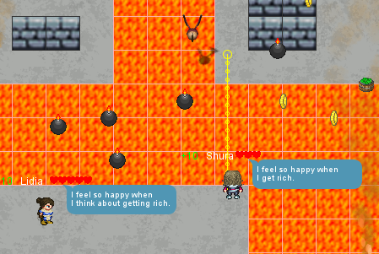
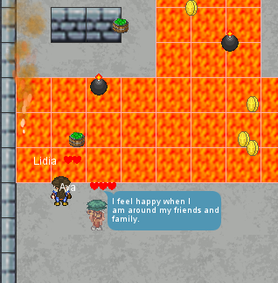
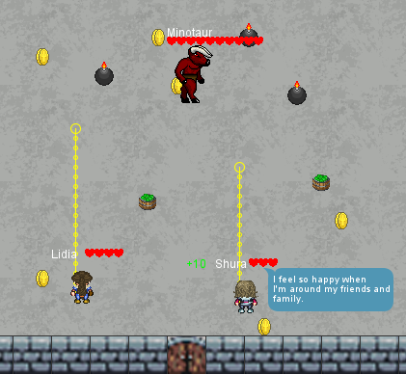
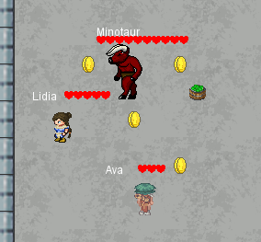
Quest mode allows you to fight your way through the dungeons while protecting Avalon! Be careful, if Avalon dies, the game will end
Compete with a friend, race to collect items to increase your score, while battle enemies – together or all for one!
Notes:
Voiceover: Besides taking on the dungeon challenge alone as Lidia, there are also two player mode and quest mode. Two player mode allows you to complete all 10 dungeons along side a friend. Scoring is kept separate so that you and a friend can compete for the high score. Quest mode adds an extra layer of difficulty to the single player mode. Not only does Lidia need to get out safely, Avalon needs to also. The player will help the A.I controlled Avalon through all 10 dungeons. You can also play quest mode with another player, which will make the challenge simpler.

Slide 10
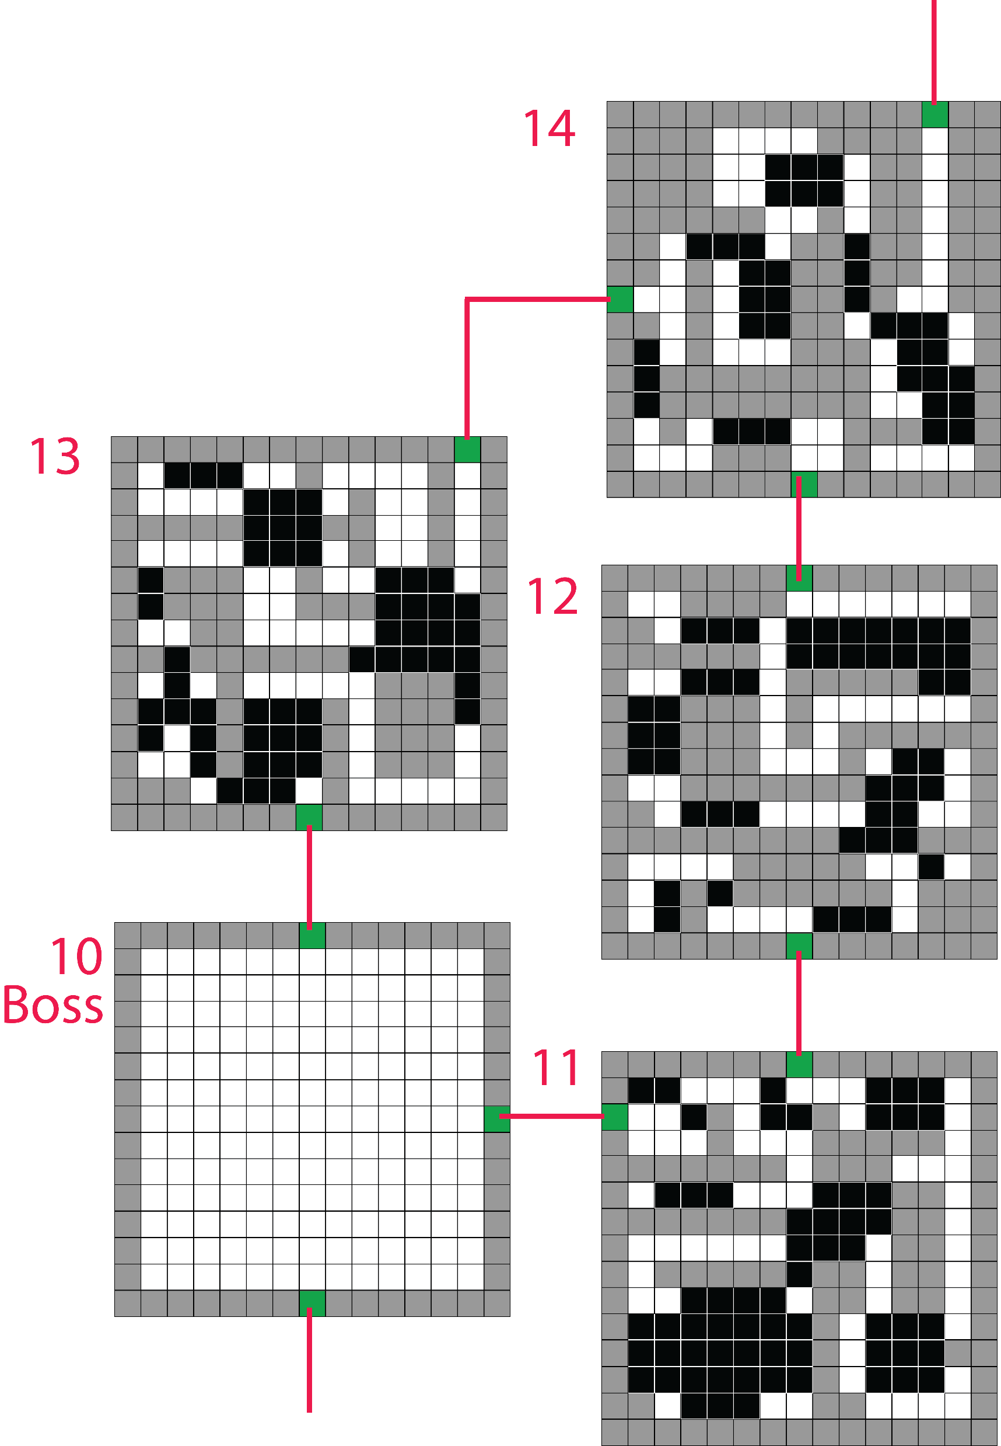
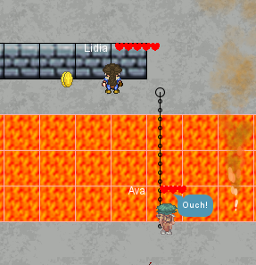
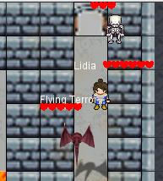
More levels
Additional boss fight
More complex puzzles
A greater variety of enemies
Enhanced A.I
Dramatic lighting
Improved movement
Notes:
Voiceover: There are many things we can improve. More levels, which will include additional boss fights and more complex puzzles. As the player gets deeper into the dungeons, there will be more enemies to flight off. Our game architecture is designed in such a way that its simple to add more levels or AI characters to the game. Our A.I system is always advancing and with each subsequent game release, A.I for both Avalon and enemies will enhance gameplay. Mood has been created by sound and player movement, but this could be made better with dynamic lighting through each level. We can also introduce different theme music for each level and more fun NPC comments from ChatGPT. The game is based on a grid system which we can always add better smoothing to make the movements less rigid.

Slide 11
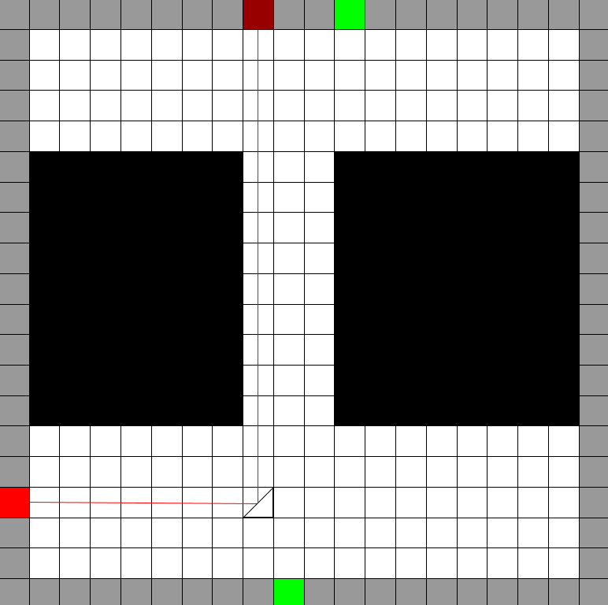
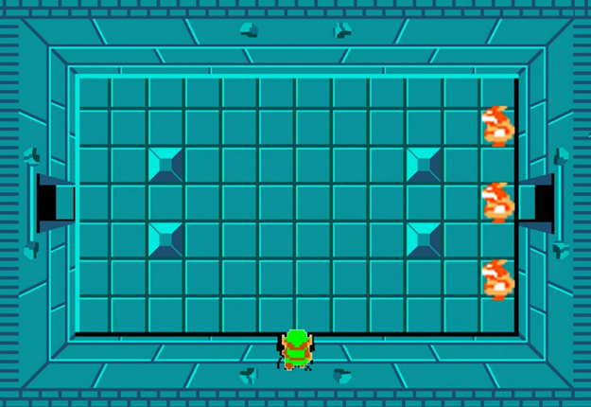

Mouse-Aim Grapple
Additional Puzzles:
Lasers
Boxes
Buttons
Switches
Timed-Doors
Keys
Additional Enemies
Shield
Sword
Different uses for the grapple
Variety in gameplay
Notes:
Voiceover: Additionally, the game was going to have a grapple that follows the players mouse, acting as a way to aim the grapple hook, 360 degrees. The grapple had to eventually be scaled down to being aimed with 4-directional movement (up, down, left, right) due to difficulties with implementation, and redundancy with the games grid-based level design. Furthermore, with the original concept heavily inspired by dungeons in the Legend of Zelda, there was consideration to add other elements to add to the diversity to the rooms the player could encounter such as lasers the player can redirect, boxes players can move, buttons, switches, and locked doors requiring speed and precision, allowing for different applications of the grapple hook. To deal with enemies, additions such as a shield and sword may also be useful in implement in later iterations of the game.

Slide 12
Game Developers:
Bryce Cameron #07262361
Josh Anderson #21018241
Helen McCartney #20023665
Jerry Hsiung #18044188
Notes:
Trailer

